Slide 1
DataLake – User Generated Data Upload Process
Components:
Windows Server ( KFDatalake01 )
File share and batch processing
AWS Glue
AWS ETL
AWS Lambda Functions & Layers
AWS FIFO Queues ( Message Passing )
AWS Cloudwatch ( Timers and Watchers )
Note: Crawler & ETL steps are created dynamically via Boto API.
Application Pattern
Publish and Subscribe via Message Passing
Each stage has a publish and subscribe lambda except stage 3.
Code is located here:
https://kochag.visualstudio.com/KochAg/_git/da-datalake

Slide 2
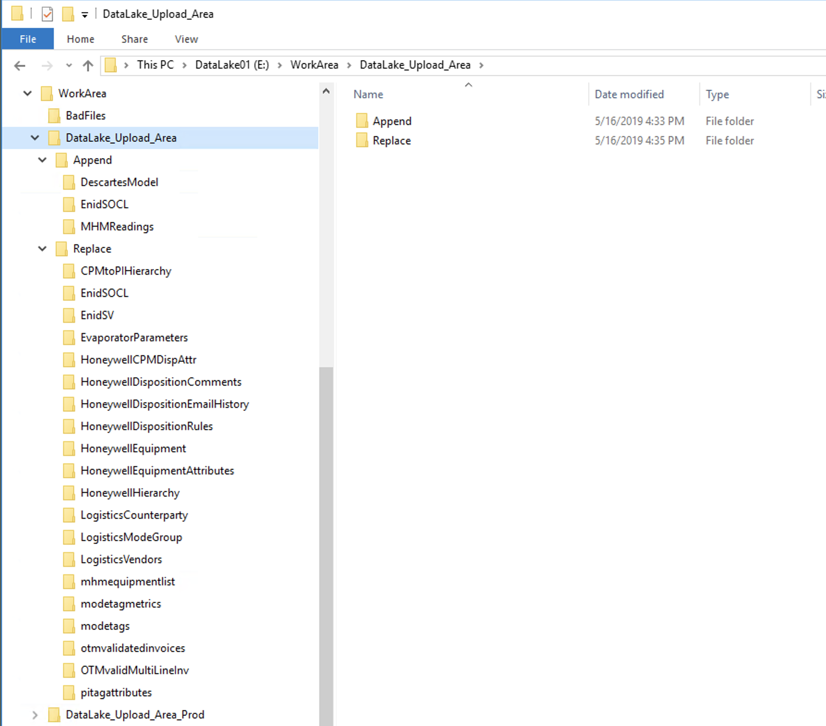
Where it starts – KFDATALAKE01
User of this process are added to the correct AD group for read / write access.
GG_KAES_DataLake_Upload_UAT
GG_KAES_DataLake_Upload_Prod
Map a local drive on their computer to either the non-prod or prod upload areas.
//kfdatalake01/DataLake_Upload_Area
//kfdatalake01/DataLake_Upload_Area_Prod
There are two modes for the data to be uploaded as:
Append
Replace
A user creates a directory in whatever mode they wish for the dataset they are going to upload. This directory will become the table name in the db ( Redshift ) with “ug_” prepended.
The new dataset ( only csv files are supported ) is placed it the directory.
At 10 min intervals a local process scans the directories for new files and uploads them to S3 in a similar structure.

Slide 3
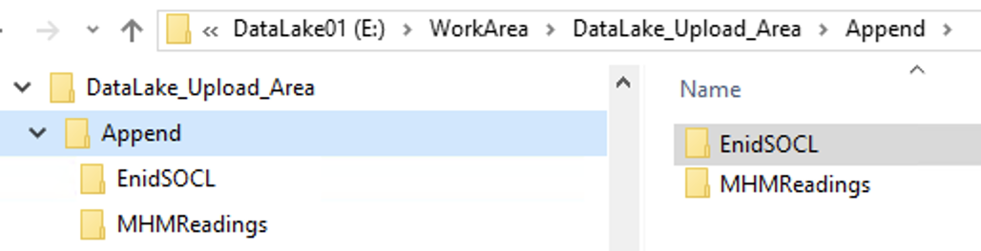



Batch Process High Level Summary
User creates directory and adds files into directory.
1
Power BI
KFDataLake Upload Process
( 10 min Interval )
Tableau
2
Redshift Spectrum
Adv. Analytics
Stage 1 – Data discovery and cataloging
3
Stage 2 – Cleanup and Invoke ETL
4
Stage 3 – Creates / Updates Parquet files and exposes data as external Redshift table
Stage 4 – Cleanup and completion

Slide 4

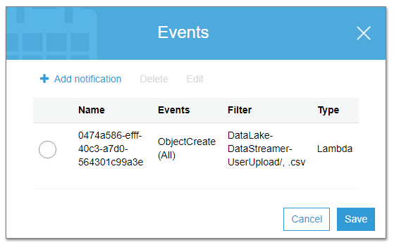
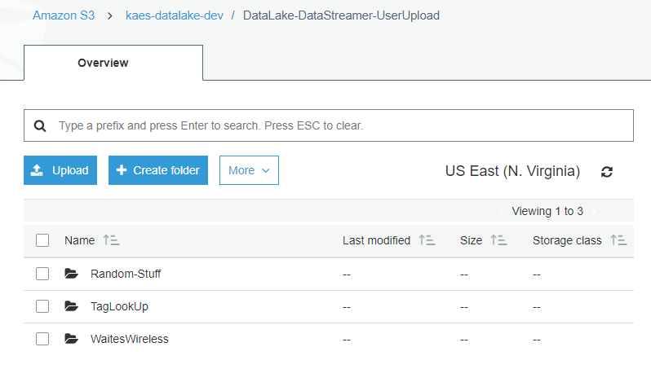




Stage 1 – Data discovery and cataloging
1
User Upload
Sends message to queue
Retrieves Pending messages
2
3
6
5
kaes_datalake_stage1_publisher
kaes_datalake_stage1_queue.fifo
kaes_datalake_stage1_subscriber
Glue Crawler Process runs on newly uploaded dataset.
7
4
kaes_datalake_stage1_queue_timer_monitor
Metadata Exposed in Redshift Spectrum

Slide 5
Code Overview – Stage 1
Layer:
KAES_Datalake
Datalake_Config
* Layers are common modules / code that can be shared between lambda functions. These are shared throughout the stages for common items.
Lambda:
kaes_datalake_stage1_publisher
Lambda_handler is called via S3 create event on bucket
Function parses event data to extract relevant data.
Places message in queue and exits
kaes_datalake_stage1_subscriber
Lambda_handler by cloud watch timer at 2 min intervals.
Polls stage1 FIFO queue for any pending messages.
If message present start Glue Crawler with message parameters else exit.

Slide 6
Stage 2 – Cleanup and Invoke ETL
kaes_datalake_discovery_crawler
kaes_datalake_stage2_queue.fifo
Sends message to queue that discovery crawler done.
Retrieves Pending messages
1
Notification that the discovery crawler succeeded.
2
4
kaes_datalake_stage2_subscriber
Deletes crawler
Creates and starts ETL process
kaes_datalake_stage2_publisher
3
kaes_datalake_stage2_queue_timer_monitor

Slide 7
Code Overview – Stage 2
Cloud Watch:
kaes_datalake_discovery_crawler
When the stage 1 Glue Crawler completes this will invoke the state2_publisher lambda.
Lambda:
kaes_datalake_stage2_publisher
Lambda_handler is called via Cloud Watch Rule once the Glue Crawler is completed.
Function parses event data to extract relevant data.
Places message in queue and exits
kaes_datalake_stage2_subscriber
Lambda_handler by cloud watch timer at 2 min intervals.
Polls stage2 FIFO queue for any pending messages.
If message present start Glue ETL job with message parameters else exit.
Cleans up previous Glue Crawler

Slide 8
Stage 3 – Expose Parquet as external Redshift table
2
Glue ETL Process runs and send message to queue when complete.
kaes_datalake_stage3_queue.fifo
Sends message to queue that ETL Job complete.
1
Creates Parquet dataset in S3
Retrieves Pending messages
4
kaes_datalake_stage3_subscriber
Creates & Starts Parquet Crawler
3
Redshift Spectrum table of Parquet Dataset
kaes_datalake_stage3_queue_timer_monitor

Slide 9
Code Overview – Stage 3
Glue ETL:
The glue ETL process that was started at the end of stage 2 will publish a message to the stage3 queue once it has completed.
kaes_datalake_discovery_crawler
When the stage 1 Glue Crawler completes this will invoke the state2_publisher lambda.
Lambda:
kaes_datalake_stage3_subscriber
Lambda_handler by cloud watch timer at 2 min intervals.
Polls stage3 FIFO queue for any pending messages.
If message present start Glue Crawler against parquet dataset with message parameters else exit.
Cleans up previous Glue ETL job.

Slide 10
Stage 4 – Cleanup and completion
1
kaes_datalake_reverse_crawler_publisher
kaes_datalake_stage4_queue.fifo
Sends message to queue that discovery crawler done.
Retrieves Pending messages
4
Done
kaes_datalake_stage4_publisher
kaes_datalake_stage4_subscriber
Deletes crawler
Deletes ETL Job
2
3
kaes_datalake_stage4_queue_timer_monitor

Slide 11
Code Overview – Stage 4
Cloud Watch:
kaes_datalake_reverse_crawler_publisher
When the stage 3 Glue Crawler completes this will invoke the state4_publisher lambda.
Lambda:
kaes_datalake_stage4_publisher
Lambda_handler is called via Cloud Watch Rule once the Glue Crawler is completed.
Function parses event data to extract relevant data.
Places message in queue and exits
kaes_datalake_stage4_subscriber
Lambda_handler by cloud watch timer at 2 min intervals.
Polls stage4 FIFO queue for any pending messages.
Cleans up previous Glue Crawler and table created in stage 1 since it is no longer needed.

Slide 12
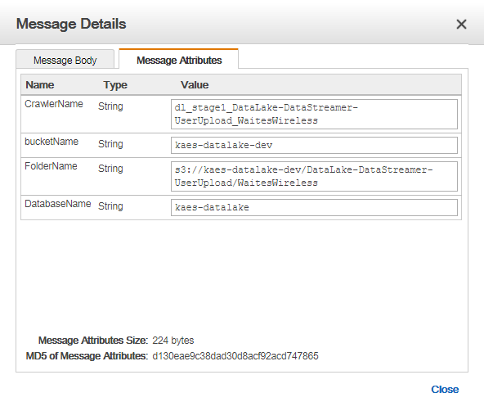
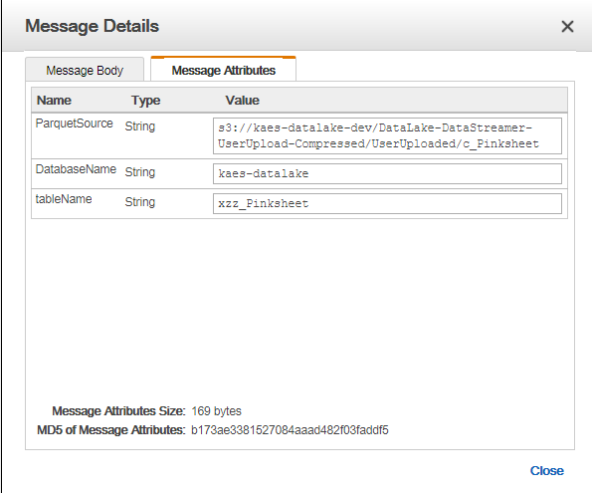
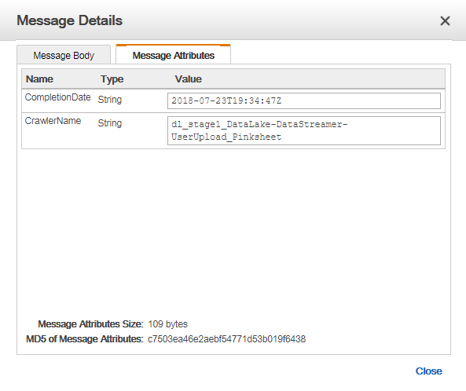
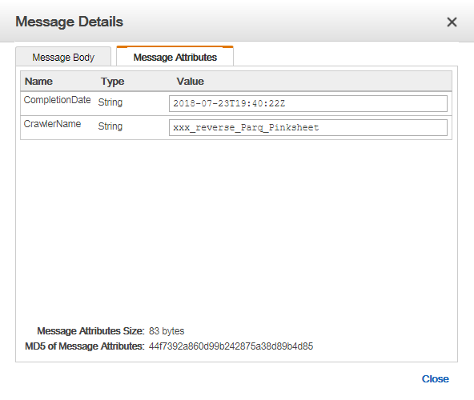
Message Queue1
Message Queue 3
Message Queue2
Message Queue 4

